Slide 1



SkillsBuild
DATA ANALYTICS
-Uncover, Analyze, Thrive

Slide 2

A
B
O
U
T
M
E
NAME : CHIMMIRI SAI GANESH
SKILLSBUILD EMAIL ID : info.saiganeshchowdary@gmail.com
COLLEGE NAME : RISE KRISHNA SAI PRAKASAM GROUP OF INSTIITUTIONS
INTERNSHIP DOMAIN : DATA ANALYTICS
INTERNSHIP START DATE : 05-06-23
INTERNSHIP END DATE : 23-07-23

Slide 3


Project topic
Doctor Visit Analysis

Slide 4
A
G
E
N
D
A
1
ABOUT PROJECT
2
PROJECT OVERVIEW
3
END USERS
4
SOLUTION AND VALUE PROPOSITION
5
CUSTOMIZING THE PROJECT
6
UNIQUE ASPECTS
7
RESULTS
8
REFERENCE

Slide 5
In this project, our aim is to analyze doctor visits using
Python
• The problem statement of my project is doctor visit analysis that is based on their age and other factors how many patients are visited a doctor to
cure their diseases.
• The data consists of income, gender, age, illness, reduced and some other
factors.
• So in this project I am analyzing how these factors affects the patients and
is they have benefited by visiting the doctor and some other queries
About Project

Slide 6
Project Overview
The Doctor Visit Analysis project aims to analyze and evaluate data related to doctor visits, with the goal of gaining insights into patient behavior, healthcare trends, and improving overall healthcare outcomes.
Data Collection
Data Analysis
Various data analysis techniques will be employed to derive meaningful insights from the collected data.
The project will require obtaining data from various sources, including electronic health records (EHRs), patient surveys, hospital databases, and other relevant healthcare systems.
Outcome and Deliverables
Project Timeline
Comprehensive analysis report summarizing key findings, trends, and recommendations.
Data visualization dashboards for real-time monitoring and exploration of doctor visit data.
The project timeline will depend on the scale and complexity of the data analysis involved

Slide 7





The End Users
Healthcare Providers
Researchers and Academics
Doctors, nurses, and other healthcare professionals can utilize the analysis results to gain insights into patient demographics, common medical conditions, treatment patterns, and patient satisfaction. This information can aid in making informed decisions about diagnosis, treatment plans, and improving the quality of care.
Researchers in the medical field can use the analysis results for further investigations, publications, and academic studies. The findings can contribute to medical research, epidemiological studies, and the development of healthcare guidelines.
Insurance Companies
Hospital Administrators
Administrators and managers in healthcare institutions can utilize the analysis to optimize resource allocation, improve scheduling, and streamline operations. They can identify peak visit times, allocate staff efficiently, and make informed decisions about facility management.
Insurance providers can benefit from the analysis by gaining insights into the cost and frequency of doctor visits, prevalent medical conditions, and treatment patterns. This information can assist in adjusting insurance plans, setting premiums, and identifying potential areas for cost savings.

Slide 8
Solution and Value Proposition
Solution :
Value Proposition :
Our Doctor Visit Analysis solution offers a comprehensive and data-driven approach to analyzing doctor visit data, providing valuable insights into patient behavior, healthcare trends, and opportunities for improvement. By leveraging advanced analytics techniques, including data mining, machine learning, and visualization, our solution enables healthcare providers, administrators, policymakers, and researchers to make informed decisions and enhance patient care.
Improved Patient Care: By analyzing doctor visit data, healthcare providers can gain insights into patient demographics, prevalent medical conditions, and treatment patterns.
Enhanced Operational Efficiency: Hospital administrators can optimize resource allocation, streamline scheduling, and reduce waiting times by analyzing the duration and frequency of doctor visits. Evidence-Based Decision Making: Policymakers and public health authorities can utilize the analysis results to monitor public health trends, allocate resources for preventive measures, and develop evidence-based policies and interventions to address emerging health concerns.

Slide 9
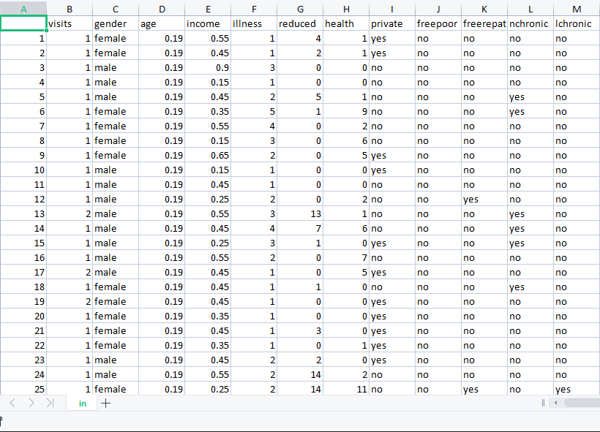
Data Set
This is how the data set looks like
The dataset used for the doctor visit analysis project contains a comprehensive collection of patient-related information captured during medical visits.

Slide 10
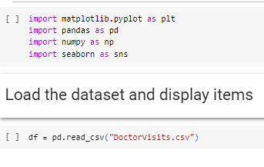
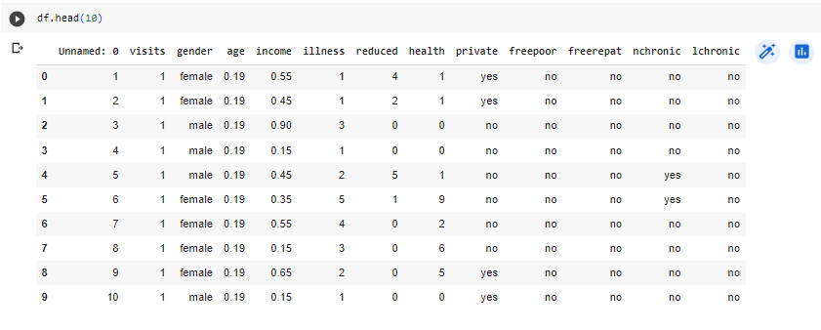
we have to import required libraries for the project, then we fetched an .csv(comma separated values) file which contains our dataset.
we work on preparing the raw data and making it suitable for data analysis. When creating a data analysis project, while doing any operation with data, it is mandatory to clean it and put in a formatted way.
Loading Data
Using python libraries

Slide 11
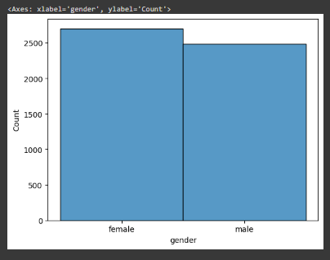
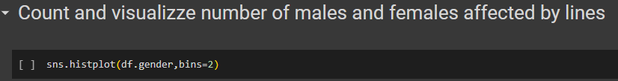
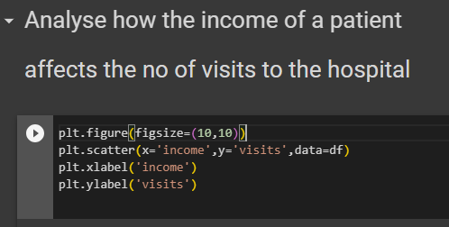
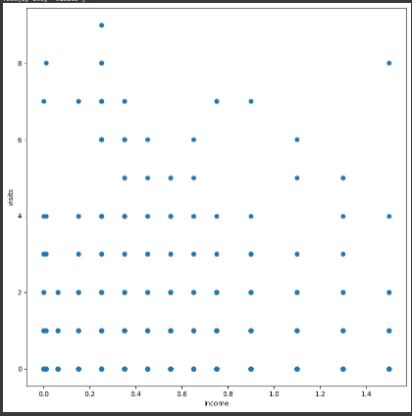

Slide 12
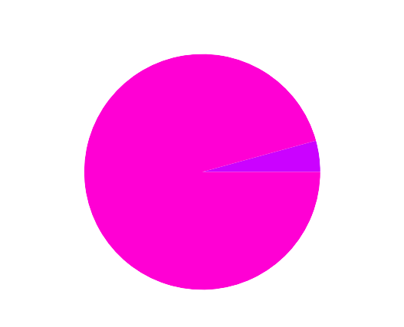
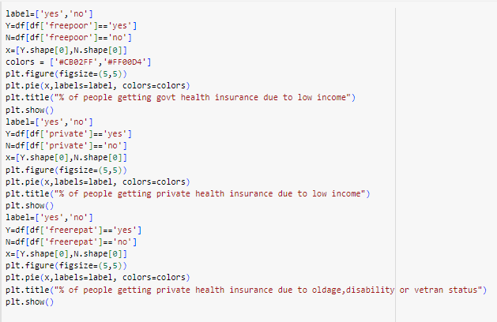
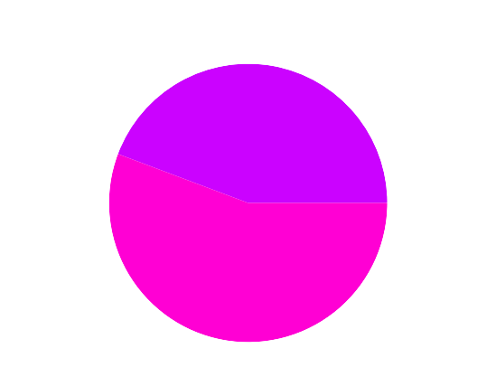
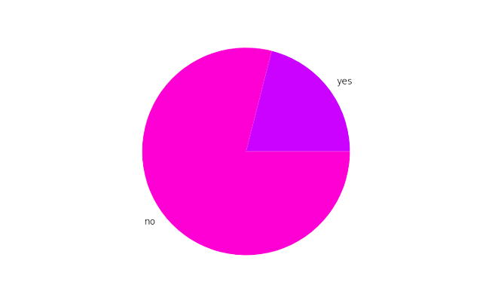
% of people getting govt health insurance due to low income
% of people getting private health insurance due to low income
% of people getting private health insurance due to oldage,disability or vetran status

Slide 13
Reference Links
Pan American Health Organization (PAHO). (2016). Monitoring and Analysis of the Availability and Use of Medicines at the Health Facility Level. Available at: https://iris.paho.org/bitstream/handle/10665.2/28297/9789275118953_en.pdf
Centers for Disease Control and Prevention (CDC). (2020). National Ambulatory Medical Care Survey. Available at: https://www.cdc.gov/nchs/ahcd/about_ahcd.htm
National Institutes of Health (NIH). (2019). Using Data Analytics to Improve Health Care. Available at: https://www.nih.gov/news-events/nih-research-matters/using-data-analytics-improve-health-care
Agha, L. (2019). The Use of Electronic Health Records for Public Health Surveillance: A Review of Current Literature. Journal of Medical Internet Research, 21(8), e13306. doi: 10.2196/13306

Slide 14
Result
1. Patient Demographics: The analysis can reveal information about the age distribution, gender breakdown, geographical location, and socioeconomic characteristics of patients visiting doctors. This information helps understand the patient population and tailor healthcare services accordingly.
2. Common Medical Conditions: By analyzing the reported symptoms and diagnoses during doctor visits, the analysis can identify the most prevalent medical conditions. This insight helps healthcare providers prioritize resources, plan treatment protocols, and allocate funding for research and prevention.
3. Visit Duration and Waiting Times: The analysis can provide information on the average duration of doctor visits and waiting times experienced by patients. Identifying peak hours and bottlenecks in the system can help healthcare providers optimize scheduling, reduce waiting times, and improve overall patient satisfaction.
4. Patient Satisfaction: Analyzing patient feedback and satisfaction surveys can provide insights into patient experiences during doctor visits. It helps identify areas of improvement in terms of communication, care coordination, and overall patient-centered care.
5. Treatment Patterns and Prescriptions: The analysis can uncover patterns in treatment plans and prescriptions, including medication adherence rates, common medications prescribed, and potential gaps in adherence to clinical guidelines. This information can guide healthcare providers in improving treatment efficacy and medication management.
6. Preventive Measures and Screenings: By evaluating the data, the analysis can assess the effectiveness of preventive measures, such as vaccinations and screenings, in reducing the incidence of chronic diseases. This insight helps healthcare providers focus on preventive healthcare strategies and allocate resources accordingly.
7. Trends and Patterns Over Time: By monitoring and analyzing doctor visit data over time, the analysis can detect emerging health concerns, identify changing disease patterns, and assess the impact of healthcare interventions or policies. This information can inform public health initiatives and guide future healthcare planning.
These results, presented through comprehensive analysis reports, data visualizations, and actionable recommendations, can support evidence-based decision-making, improve healthcare outcomes, and enhance the overall delivery of healthcare services.

Slide 15
GitHub Link
https://github.com/SaiGaneshChimmiri/IBM_DATA_ANALYTICS_PROJECT

Slide 16
Thank You
- presented by Chimmiri Sai Ganesh

